Slide 1

Project 2. Design Space Exploration of Distributed Machine Learning Systems: The choice of configuration parameters in distributed machine learning and their impact on training time and overall model performance. Denise S. Davis, MS and Pooyan Jamshidi, PhD
CSCE 790 Topics in Information Technology
College of Engineering and Computing,
University of South Carolina

Slide 2
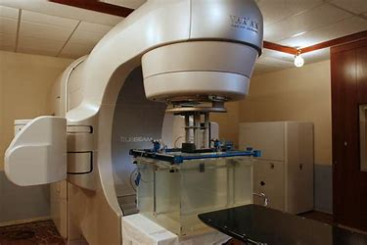
Background information
Medical Physicist
Training in Radiation Physics
Radiation Oncology high tech field in medicine
DICOM-RT
TLD (Thermo-Luminescence Dosimetry)
3D treatment planning computers
Patient Record and Verify
Wide Range of Applied Technology

Slide 3
Distributed Machine Learning TensorFlow
Two types of Execution
Model Parallel
Divide model into multiple subgraphs and place separate graphs on different nodes/devices⁺. Each subgraph performs their calculations and then exchange the variables as required.
Data Parallel
Divide the data into batches and run the same model on each batch⁺. The calculations are ran on multiple nodes/devices and then the parameters are updated and shared on a master node(parameter server).
Our project is focused on Data Parallel execution
⁺Mastering Tensorflow 1.x, Ch 15. Jaokar, Ajit. 2018.

Slide 4
Replicate the model under Data Parallel strategy
In Graph Replication
Single client task owns the model parameters and assigns model calc to multiple worker tasks.
Between Graph Replication
Each Client task connects to its own worker to assign model calc. All the workers update the same shared model. A Chief Worker is responsible for initializing the model parameters only once.
Our project utilizes Between Graph Replication

Slide 5
Update the parameters: Between Graph Replication
Synchronous Update
Parameter server waits to receive updates from all workers before updating gradients. One slow worker will slow down the entire operation.
Asynchronous Update
Workers send updates to parameters. Parameter server applies updates as soon as they are received and sends back updated parameters to worker.
Improve performance lowering learning rate and batch size.
Our project may investigate both schemas.

Slide 6
TensorFlow Steps for implementation
Define the cluster specification
Create a server to host a task
Define the variables to be assigned to the parameter server tasks
Define the operations/calculations to be replicated on all the worker tasks
Create a remote session
Train the model in the remote session
Use the model for prediction
⁺Mastering Tensorflow 1.x, Ch 15. Jaokar, Ajit. 2018.

Slide 7
Parameters, datasets, hyper-parameters
Static
Variable
Dataset and labels
# of Outputs and Inputs
Learning rate
# of epochs
Batch size
# of batches
Input
Weights
Biases
Output
Cost function
Accuracy
Model is the same on every worker

Slide 8
Useful Hints TensorFlow
clusterSpec = tf.train.ClusterSpec()
server = tf.train.Server()
package tf.flags to make python scripts dynamic
config = tf.ConfigProto()
Controls GPU’s and CPU memory allocation
server.join()
Allows parameter server to stay active until all workers have finished and then you can exit cleanly
Know your ports!!
Parameter server has to be started first!
Then each worker can be initiated…seems basic but still…

Slide 9
Experiments with MNIST data single layer sigmoid neural network with backpropagation
Asynchronous updates with between graph replication
Vary placement of parameter server and worker server
Vary #epochs (20, 40, 100, 200, 300, 400, 500)
Starting with 400 epochs vary batch size to improve model performance
3 Server configurations with 1 parameter server and 1-3 worker servers
Measure training time and accuracy of model on each server

Slide 10
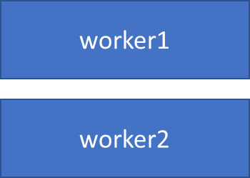
A
worker1
B
Parameter Server
worker2
Node1
PS node
Parameter Server
worker1
Worker node
C
Node 2
worker2
Parameter Server
Same node
“Local host”
worker3
Note: only have 2 nodes for research

Slide 11
Comparison of results for all 3 configurations

Slide 13
Summary of Scenario C
All worker servers finish within msec of each other.
Model accuracy is the same on each worker
Tested from 20 epochs up to 500 epochs with same batch size
Training time increased linearly with number of epochs with multiple workers
Decreased batch size and accuracy improved to 90% for 400 epochs

Slide 16
Summary of Scenario A
Only sampled this setup
Confirmed results from C
Worker Servers will finish at the same time and same accuracy
Slower due to communication with parameter server on different node
Training time 3 times slower than that of Scenario C.
Accuracy of A the same as C

Slide 17
Summary of Scenario B
Dedicated server has better accuracy, longer training time.
Local server has shorter training time, worse accuracy.
Conclude that the actual time to calculate on each server is similar. The longer training time is due to communication over the network.

Slide 18
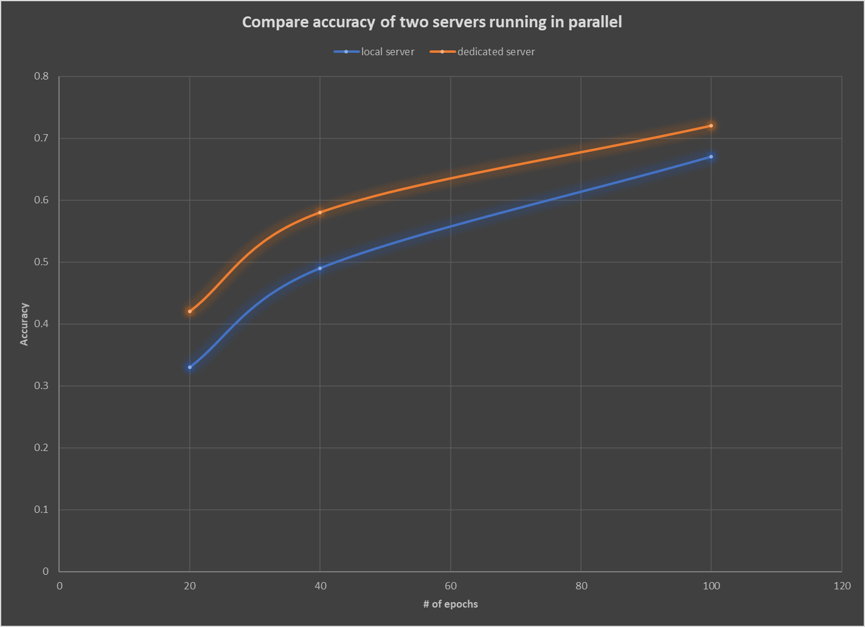

Slide 19
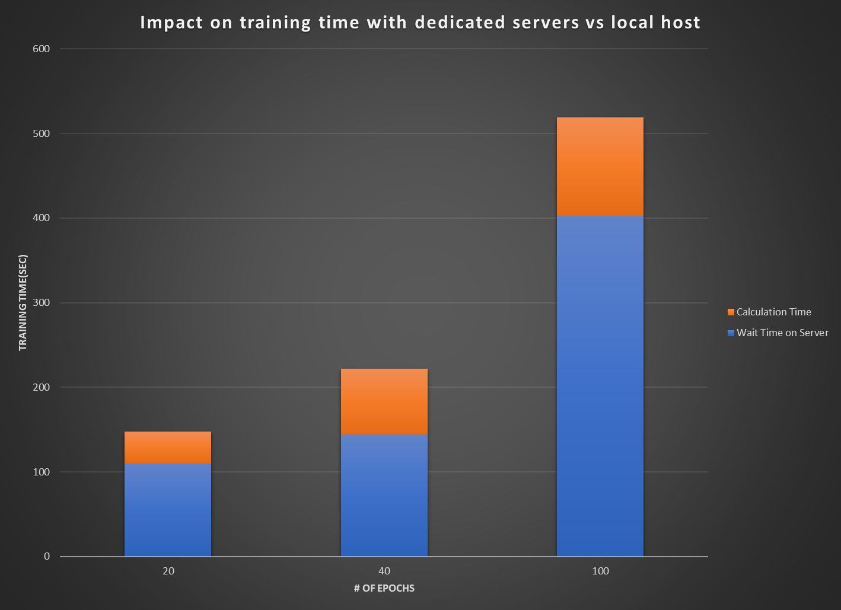

Slide 20
A
worker1
B
Parameter Server
worker2
Node1
PS node
Parameter Server
worker1
Worker node
C
Node 2
worker2
Parameter Server
Same node
“Local host”
worker3
Note: only have 2 nodes for research

Slide 21
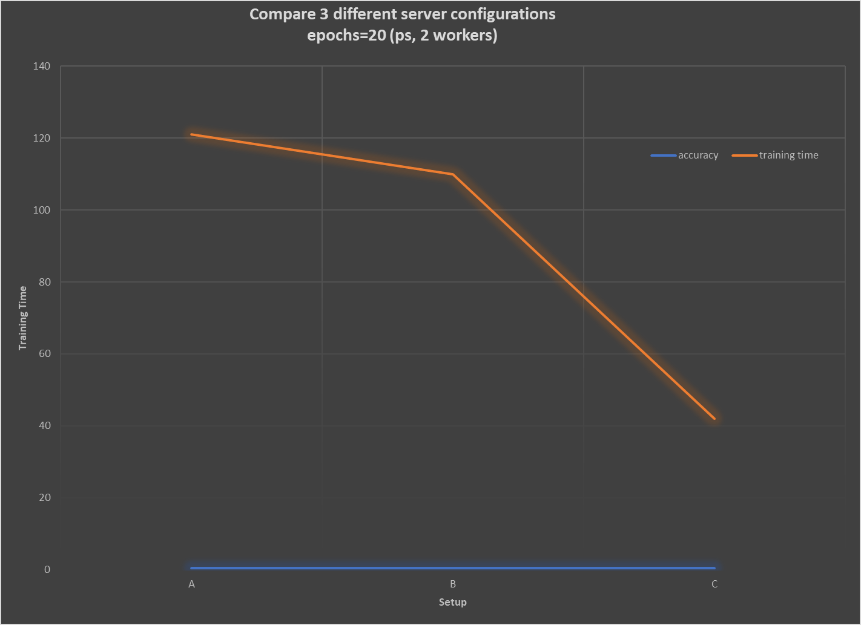

Slide 23
Acknowledgements/resources
Mastering TensorFlow 1.x, Fandango, Armando, 2018.
Hands-On Machine Learning with SciKit-Learn and Tensorflow, Geron, Aurelion, 2017.
https://www.tensorflow.org/deploy/distributed
MNIST demo scripts from ischlag.github.io

